Slide 1
Environmental, Social and Governance Report 2022-23
Virgo Polymer (India) Ltd.

Slide 2
A brief of report
Welcome to Virgo Polymer’s first ESG Report, providing a thorough overview of our unwavering commitment to incorporating sustainability across all facets of our operations. This report serves as a testament to our steadfast dedication to Environmental, Social, and Governance (ESG) principles and outlines our strategic management approaches to realize our sustainability objectives.
This report has been prepared with reference to GRI Sustainability Reporting Standards 2022, the report can be accessed online athttps://fibcbigbags.com/contact.php.
Scope and Limits of Reporting: This report encompasses the timeframe from April 1, 2022, to March 31, 2023, presenting a comprehensive insight into our sustainability performance and strategies. It sheds light on our conscientious practices, governance framework, and initiatives aimed at fostering positive change. Our primary operational base is located in Maraimalai Nagar, Kancheepuram, Tamil Nadu.

Slide 3
VPIL at a Glance
Virgo polymer (india) limited based in chennai , tamil nadu , producing 500 tons a month of type A non-food grade FIBC for domestic, europe, UK, USA and other markets since last 24 years. We are a leading manufacturer's of type A FIBC based at a port city in india and taking advantage of fastest shipment and cost effectiveness. We are an ISO 9001:2015 & ISO14001:2015 certified company, an indian government recognised export house, a member of IFIBCA association and a holder of various certificates.
We at virgo also have fully established in-house research & development (R&D) who continuously works on offering cost - efficient and safe packaging solutions. To support the R&D function, we have the most modern in-house test laboratory equipped with load test rig, UV weather meter, MFI tester and all other required test equipment's

Slide 4
Visions and Growth Strategy
1. Market Expansion: VPIL envisions penetrating new markets and increasing its global footprint through strategic market expansion initiatives.
2. Product Diversification: VPIL aims to enhance its product portfolio by diversifying offerings to meet evolving market demands and cater to a broader customer base.
3. Technological Advancement: VPIL is committed to staying at the forefront of technological innovation, investing in advanced technologies to improve manufacturing processes and product capabilities.
4. Customer-Centric Approach: VPIL's vision involves placing customers at the center of its operations, ensuring a personalized and customer-focused experience throughout the product lifecycle.
5. Talent Development and Retention: VPIL prioritizes talent development and retention strategies to nurture a skilled workforce, fostering innovation and employee satisfaction.
6. Sustainability Initiatives: VPIL is dedicated to integrating sustainability into its core business operations, implementing initiatives to reduce environmental impact and promote responsible business practices.
7. Operational Excellence: VPIL aims for operational excellence by optimizing efficiency, minimizing waste, and continuously improving processes to deliver high-quality products and services.
8. Strategic Alliances and Mergers: VPIL seeks strategic alliances and mergers to strengthen its market position, foster innovation, and create synergies for sustained growth.
9. Brand Building: VPIL focuses on brand building through effective marketing strategies, emphasizing its values, quality, and reliability to enhance brand recognition and customer loyalty.
10. Agility and Adaptability: VPIL values agility and adaptability, responding swiftly to market changes, technological advancements, and customer preferences to stay ahead in a dynamic business environment.

Slide 5
Materiality Assessment
Key Steps of materiality Assessment
Virgo polymer employs a systematic materiality evaluation process, aligning with GRI standards, to identify and report on key aspects of our business, spanning environmental, social, and governance dimensions. This assessment, conducted in FY 2022-23, aims to comprehend topics crucial to both our organization and stakeholders. Our emphasis on impact materiality procedures underscores our commitment to transparency, accountability, and sustainability.
Our key stakeholders:
Customers,
Employees and contractual labourers,
Investors,
Community, suppliers and vendors
Identification of Stakeholders
Identification of Sustainability Topics
Prioritization of Topics
Stakeholder Engagement
Materiality Matrix
Review and Validation

Slide 6
ENVIRONMENT
Climate change and energy management
Carbon emission
Water management
Air emission and control
Waste management

Slide 7
Climate Change and Energy Management
Virgo Polymers demonstrates effective energy resource management by employing a diverse mix, incorporating purchased electricity, renewable energy (wind power), and diesel. The company emphasizes the significance of monitoring energy consumption, maintaining comprehensive records to analyze usage patterns, and highlights this commitment in the sustainability report. Looking forward, Virgo Polymers is committed to transitioning towards green energy sources, aligning with broader sustainability goals and showcasing a proactive approach to contribute to a cleaner and more environmentally responsible energy landscape.
Renewable Energy:
Virgo Polymers is committed to sustainable practices, prominently utilizing purchased wind energy as a major source in its energy mix. This strategic choice aligns with the company's dedication to reducing its environmental footprint and underscores its proactive approach in adopting clean and renewable energy sources. By prioritizing purchased wind energy, Virgo Polymers exemplifies its commitment to fostering a greener, more sustainable future in its operations.
KPI’s | % of Renewable energy usage in the operations over period.
Targets | 65% of Renewable energy usage by the end of 2025; 75% by the end of 2030.
Energy Consumption Details For the Period From 1st Apr-2022 to 31st Mar-2023
Consolidate Energy Consumption- VPIL
Energy Source | Electricity | Diesel | Wind Power
Total Consumption | 658955 KWh | 1200 L | 3478137.4 KWh
Total Energy Consumption ( GJ) | 2372.23 | 48.237 | 12521.3

Slide 8
CARBON EMISSION
Virgo Polymers takes a proactive stance in addressing its environmental impact by conducting thorough greenhouse gas (GHG) calculations and meticulously maintaining yearly data. Recognizing the significance of GHG emissions in the context of climate change, the company employs robust measurement and reporting mechanisms to quantify its carbon footprint accurately. By tracking and analysing emissions data on an annual basis, Virgo Polymers gains valuable insights into its environmental performance. This commitment to GHG calculations not only aligns with global sustainability standards but also serves as a foundation for the company's ongoing efforts to implement eco-friendly practices, reduce emissions, and contribute to a more sustainable and climate-resilient future.
VPIL has calculated Scope 1 and 2 GHG emissions in FY 2022-23, which included the following activities:
Scope 1: Stationary and Mobile Combustion, and Refrigerants
Scope 2: Purchased Electricity
Scope 1 (tonne CO2e) | Scope 2(Location-based) (tonne CO2e)
3.83 | 528.25
In alignment with the forecasts, VPIL has established an internal goal to achieve a 20% reduction in emissions by the year 2035, using the 2022-2023 period as the baseline for comparison.

Slide 9
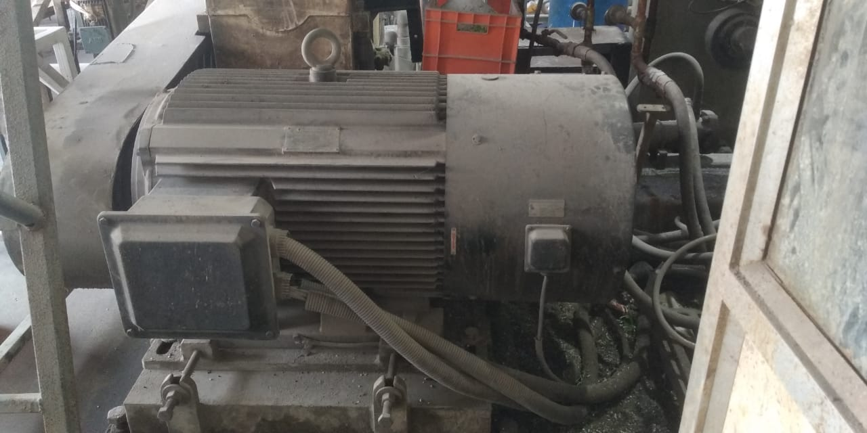
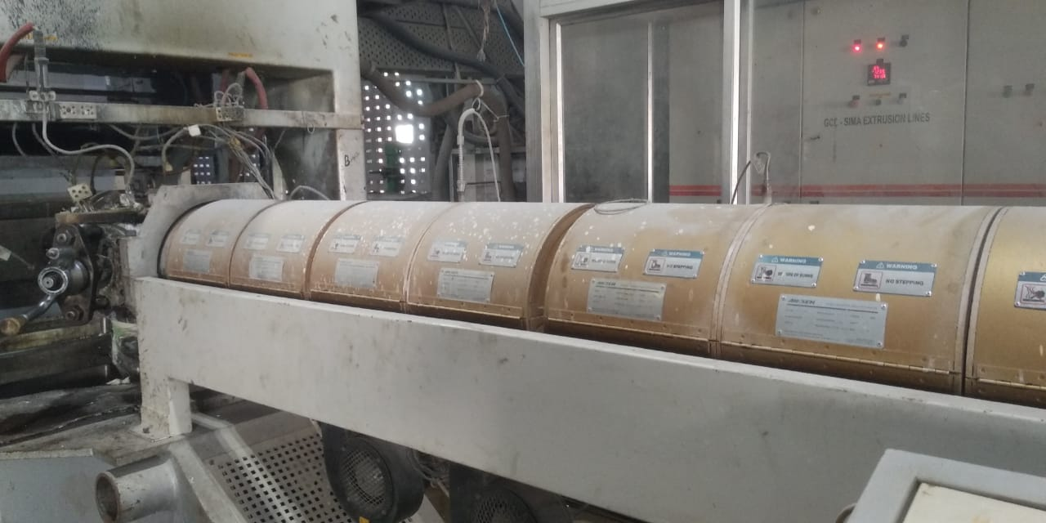
Our Energy Efficiency programs
At VPIL, our commitment to energy efficiency is evident in our proactive measures, VPIL has purchased energy efficient motors and heater to further bring down the energy consumption in its operations.
Energy Efficient Motor:
We have implemented high-efficiency permanent magnetic variable frequency synchronous electric motors. These motors deliver the same output strength while consuming a significantly lower amount of power. Operating at efficiencies typically 2.6% higher than standard motors, they not only enhance output efficiency but also contribute to the protection of other devices. For instance, the main motor of our tape plant, with a rated amps of 242 A, operates at just 215 A with load, showcasing substantial energy savings.
Infrared Heater:
In the heating domain, we prioritize energy efficiency by employing infrared heating, recognized as one of the most energy-efficient methods for warming warehouses and factories. To ensure precise temperature control, we use the PXF4 model temperature controller, managing the range from set point to PV point. This strategic approach to heating not only enhances energy efficiency but also aligns with our broader commitment to sustainability.

Slide 10
ENERGY CONSERVATION INITIATIVES
Virgo Polymers is steadfast in its commitment to energy conservation, implementing a comprehensive program that involves training employees on the importance of energy conservation. Through educational initiatives, employees are empowered to contribute actively to reducing energy consumption. The company embraces natural lighting in office areas by maximizing the use of daylight, not only enhancing the workspace environment but also minimizing reliance on artificial lighting during daylight hours.
Solar power panelled streetlights, harnessing the power of renewable energy to illuminate outdoor spaces efficiently. This initiative not only reduces our carbon footprint but also demonstrates our commitment to utilizing clean energy sources.
Energy-efficient bulbs are installed throughout the facilities. By adopting these bulbs, we not only reduce energy consumption but also contribute to a more sustainable and eco-friendly operation. These energy conservation measures collectively reflect Virgo Polymers' dedication to responsible resource management, environmental stewardship, and a commitment to sustainable business practices.
.

Slide 11
WATER MANAGEMENT
Virgo Polymers is dedicated to implementing a robust water management strategy that encompasses water recycling, conservation, and rainwater harvesting initiatives. Recognizing the significance of responsible water use, our company actively engages in practices that contribute to sustainability and environmental stewardship.
Water Recycling:
Virgo Polymers employs cutting-edge water recycling systems, particularly in our cooling processes, where water is efficiently reused to minimize wastage. Through advanced technologies, we ensure that discharged water is redirected for non-potable purposes, such as watering plants and supporting other industrial needs.
Water Conservation:
Implementing insulation techniques and efficient cooling systems, Virgo Polymers minimizes water consumption in various production and storage areas. By adopting these measures, we not only regulate temperature effectively but also significantly reduce overall water usage.
Virgo polymer uses waterless production process and thus has NOC under “Green” category.
KPI’s | 1. Water Accounting
 | 2. Recycling of 50% fresh water
 | 3. Zero discharge from facility
 | 4. Water less production process.
Targets | Yearly water accounting 50% recycling of fresh water into the chiller and cooling system Zero Liquid discharge
Water Withdrawal & Consumption Details From 1st Apr-2022 to 31st Mar-2023
Total water withdrawal- Ground water | 3650 KL
Total water Consumption | 7300 KL
Total water recycle | 3650 KL
Total water discharge | Zero

Slide 12
Key Highlights- water management
Rainwater harvesting
Water conservation- RO system
Water Recycling- Chillers and Coolers
Our reverse osmosis (RO) plant, plays a pivotal role in this initiative. Despite a usage scenario for clean and safe drinking water, we address waste concerns by efficiently redirecting the discharged wastewater to a separate drain. This surplus of water, instead of being discarded, finds purpose in non-potable applications such as watering plants, flushing toilets, and cleaning. By repurposing wastewater for these activities, Virgo Polymers actively contributes to reducing the strain on freshwater resources and emphasizes our commitment to sustainable water management practices.
Our cooling systems designed to regulate and maintain optimal temperatures in production and storage areas, Beyond their primary function of cooling machinery, these systems are integral components of our comprehensive water recycling process. The water recycling process through chillers involves the efficient reuse of water, minimizing wastage and promoting a closed-loop system.
Virgo Polymers understands the importance of harnessing natural resources, and rainwater harvesting is integral to our sustainability efforts. Through strategically placed collection systems, we capture rainwater for reuse in various industrial processes, reducing dependency on external water sources and contributing to our broader commitment to responsible water management.

Slide 13
KEY Highlights- effluent management
Virgo polymer is proud to operate as a “Green”-category facility with both air and water consent under this environmentally conscious classification. Our commitment to sustainable practices extends to wastewater management, exemplified by the implementation of a zero-effluent facility.
In adherence to this commitment, virgo polymer treats and disposes of sewage generated on the premises through a system of septic tanks and soak pits, ensuring responsible handling and disposal. Importantly, our manufacturing processes are meticulously designed to prevent the generation of any trade effluent, showcasing our dedication to minimizing environmental impact.
As part of our broader environmental initiatives, green belts have been thoughtfully developed in and around our unit's premises. These green spaces not only contribute to the aesthetic appeal of our facility but also play a crucial role in promoting biodiversity, mitigating the environmental footprint, and enhancing the overall sustainability of our operations.
Virgo polymer's status as a green-category facility, coupled with our stringent wastewater management practices and the development of green belts, reflects our unwavering commitment to responsible environmental stewardship. We continue to strive for excellence in sustainable practices, setting a benchmark for a zero-effluent approach within our industry.

Slide 14
AIR EMISSION and control
Virgo polymers is unwavering in its commitment to environmental stewardship, particularly in managing air emissions through a comprehensive set of actions. Recognizing the critical importance of minimizing our carbon footprint, we have instituted various measures to ensure responsible air emission practices.
Training initiatives: Virgo polymers provides extensive training to all employees and workers on the significance of air emission control, emphasizing the importance of adhering to prescribed guidelines and adopting sustainable practices in day-to-day operations.
Stack and Ambient air quality Monitoring: We conduct quarterly stack and Ambient air quality monitoring, the continuous assessment and analysis of emissions from industrial stacks to ensure compliance with environmental regulations. By proactively monitoring and addressing any deviations, we strive to maintain optimal air quality levels.
Optimum height of DG stack: the height of diesel generator (DG) stacks is a critical factor in controlling emissions. We adhere to best practices by maintaining the optimum height of DG stacks (4m from ground Level). This strategic approach ensures efficient dispersion of emissions, minimizing their impact on the surrounding environment.
Noise control through enclosed DG: Virgo Polymers has adopted an enclosed DG setup. This design minimizes noise levels, creating a quieter and more environmentally friendly operational environment.
KPI’s | 1. Ambient Air Monitoring
 | 2. % trained employee
Targets | Quarterly Ambient Air Monitoring 100% training to the worker

Slide 15
WASTE MANAGEMENT
Virgo polymers is deeply committed to responsible waste management practices, reflecting its dedication to environmental sustainability. The company implements comprehensive waste reduction strategies, emphasizing the principles of reduce, reuse, and recycle throughout its operations. Virgo polymers employs state-of-the-art technologies to minimize waste generation during manufacturing processes, adhering to strict recycling protocols for materials such as plastics and packaging. Additionally, the company invests in innovative waste treatment methods, ensuring the safe and environmentally friendly disposal of any unavoidable waste. Regular audits and assessments are conducted to monitor and optimize waste management processes continuously. Virgo polymers' proactive approach to waste management underscores its commitment to minimizing its environmental footprint and promoting a circular economy.
KPI’s | 1. Reduction in waste quantity by 5%
 | 2. % trained employee
Targets | Recycling of usable plastic bins 100% training to the worker
Waste management detail for the Year 2022-23
Sr No. | Type of Waste | Type of waste | Waste quantity | Treatment Method | Amount in the stock as on (30/03 23)
1 | Chemical drum (in KG) | Hazardous | 2615 | Disposed through approved vendor | 0
2 | Spent Oil (in Litre) | Hazardous | 125 | Stored on-site | 125 lit
2 | Plastic Bin (in pieces) | Non-Hazardous | 2106 | Reused on-site | 0
3 | Orange Crate (in Kgs) | Non-Hazardous | 1120 | Reused on-site | 0
4 | Paper Core (in Kgs) | Non- Hazardous | 2964 | Sent to approved recycler | 0
5 | Barrel- PVC and Iron (In Kgs) | Non-Hazardous | 3080 | Sold to scrap | 0

Slide 16
SOCIAL
Employee health safety and wellbeing
Employee engagement and benefits
Working condition
Training and career management
Diversity and inclusion
Community strengthening- CSR activities
Human rights and child labour
Supply chain management

Slide 17
Employee health safety and wellbeing
At Virgo polymer Health, safety, and Well-being of our employees are paramount, and we are committed to fostering a workplace culture that prioritizes these values. Our approach encompasses effective communication, rigorous hazard identification and assessment procedures, and a dedication to achieving the highest safety standards.
Communication on health and safety: We prioritize transparent communication on health and safety matters by engaging our employees through various initiatives. Through face-to-face meetings, notice boards, email communication, minutes of meetings, and safety booklets, we ensure that vital health and safety information reaches all employees. This multi-channel approach aims to keep our workforce well-informed and actively involved in maintaining a safe and healthy work environment.
Hazard identification and assessment: Virgo polymers employs robust safety management procedures and systems to thoroughly evaluate and mitigate risks associated with our operations. Our EHS management system is geared towards achieving our goal of zero incidents/accidents. We conduct hazard identification and risk assessment (HIRA), activity-based risk assessment (AIA), and hazard and operability study (HAZOP) processes to comprehensively identify potential hazards and assess risks. Root cause analysis and implementation of corrective and preventive actions are integral components of our commitment to safety. Department safety coordinators play a pivotal role in ensuring safety implementation in their respective areas, and our leadership team conducts EHS loss control tours to reinforce safe workplace conditions.
Change management and process safety: Recognizing the importance of change management, all changes now undergo a thorough review and approval process by the EHS department. Additionally, we are actively working towards ISO 45001 certification demonstrating our commitment to meeting international standards for occupational health and safety.

Slide 18
Our Efforts to improve Health & Safety of Employee & Workers
At Virgo Polymers, our commitment to health and safety extends beyond compliance to actively fostering a culture of continuous improvement and preparedness. One of our key initiatives:
Regular conduct of mock/fire drills, ensuring that our workforce is well-prepared to respond effectively in emergency situations.
We have identified and adequately trained firefighters and first aid providers in Emergency Management.
we actively encourage the proactive reporting of Unsafe Acts, Unsafe Conditions, and Near Misses.
Incident reporting mechanism is integral to our commitment to continuous improvement in health and safety. We create a proactive approach to mitigating risks and preventing incidents.
KPI’s | 1. Safe working environment
 | 2. Safety training hours per person
 | 3. ISO 45001 Certification
Targets | Zero fatality 4 hrs safety training hours per person All manufacturing locations to be ISO 45000 and by the end of 2024 and 100% closure on audit actions points.
Health & Safety Performance of VPIL for the Period from 1st Apr-2022 to 31st Mar-2023
Near miss | LTI | Fatality | LTIFR (Avg Value) | LTISR (Avg Value)
61 | 8 | 0 | 10.3 | 0.00

Slide 19
Employee engagement and benefits
At Virgo, we place paramount importance on fostering a workplace environment that prioritizes the well-being, safety, and fulfilment of our employees. Our commitment extends beyond standard practices, aiming to create working conditions that not only meet regulatory standards but also exceed expectations to provide a positive and enriching experience for our workforce.
Our facilities are designed with the utmost consideration for the physical and mental well-being of our employees. Adequate ventilation, ergonomic workstations, and a commitment to cleanliness contribute to a conducive work environment.
Virgo ensures that all employees receive fair and competitive compensation, aligning with industry standards and regulatory requirements.
KPI’s | 1. % of employee receiving minimum wages
 | 2. % of employee covered under PF and gratuity benefits
 | 3. Providing health coverage
Targets | 100% of employee receiving minimum wages as applicable 100% of employees covered under PF scheme as per state government rule 100% of employees receive accidental and health insurance 100% of workers receive ESIC benefit
Employee Benefit coverage at VPIL
S. No | Employee Benefits | Male | Female
1 | Minimum wages | 100% | 100%
2 | Healthcare Coverage | 100% | 100%
3 | Parental leave | NA | 100%
4 | Provident Fund and Gratuity Scheme | 100% | 100%
5 | Workers Covered Under ESIC | 100% | 100%

Slide 20
Positive work environment
At Virgo, our commitment to employee engagement and empowerment serves as a cornerstone in cultivating a thriving workplace culture. This dedication has not only increased productivity but has also contributed to heightened job satisfaction and the retention of top talent.
Creating a vibrant work culture:
We recognize the significance of a positive work environment in nurturing employee engagement. Celebrating individual milestones is a key aspect of our culture, as we collectively rejoice in birthdays and marriage anniversaries, fostering a sense of togetherness within our team. Furthermore, our weekend fun activities are designed to infuse cheer and setting a positive tone at the workplace.
Cultural inclusivity:
At Virgo cultural diversity is celebrated with enthusiasm. From Diwali melas and Holi celebrations to Ganesh Chaturthi pooja, Pongal and Onam every cultural festivity is embraced. Our inclusive approach ensures that all employees partake in these celebrations, promoting unity and enriching the fabric of our cultural diversity.
Promoting physical and mental well-being:
Recognizing the importance of a healthy work-life balance, we organize quarterly sports tournaments featuring a variety of activities. Indoor games like carrom and chess and outdoor sports such as football, volleyball, tug-of-war, and badminton, our employees, including women, enthusiastically participate. These activities not only enhance physical fitness but also foster teamwork and provide stress relief.

Slide 21
Training and career management
At Virgo Polymers, we recognize that investing in the continuous development of our workforce is not only pivotal for individual growth but also instrumental in achieving organizational success. Our robust training and career development programs are tailored to empower our employees with the skills and knowledge needed to thrive in a dynamic industry.
Virgo Polymers is dedicated to fostering continuous employee development through comprehensive training initiatives, skill enhancement programs keeping pace with industry evolution, leadership development opportunities, a clear career progression framework, and a culture of mentorship to ensure our workforce excels in a dynamic and evolving professional landscape.
KPI’s | 1. Average hours of training per year per employee
Targets | 8 training hours per person
Training hours For the Year 2022-23
S. No | Particulars | Details
1. | Hours of Trainings conducted for employees and workers | 2848
2. | Average no of training hours provided per employee per year | 8.5
Major Area/Topics covered under Training Program:
1. Environment Management
2. Health and safety
3. Code of Conduct
4. Information Security
Skill Development Training:
1. Lean Six Sigma Training
2. Style stitching training

Slide 22
DIVERSITY AND INCLUSION
Embracing social diversity and inclusion is crucial for the development of sustainable communities. This entails recognizing and celebrating a broad spectrum of human differences, such as race, ethnicity, gender, age, sexual orientation, religion, disability, and socioeconomic status. Inclusion ensures that everyone, irrespective of their background, feels esteemed, respected, and enjoys equal access to opportunities and resources. Social diversity and inclusion form the bedrock of sustainable initiatives, fostering innovation, resilience, and a sense of belonging. This approach not only enhances the social fabric but also drives economic growth, reduces inequalities, and promotes environmental stewardship. Virgo's commitment to Diversity, Equity, and Inclusion (DEI) is evident in its employment of two individuals with disabilities, exemplifying the company's dedication to creating an inclusive workplace. As we collectively strive for a sustainable future, prioritizing and championing social diversity and inclusion becomes imperative at every societal level.
Particular | Female | Male | Total | Female % | Male %
Whole Org. | 88 | 247 | 335 | 26% | 74%
Director | - | 2 | 2 | 0 | 100%
Total | 88 | 249 | 337 | 26% | 74%

Slide 23
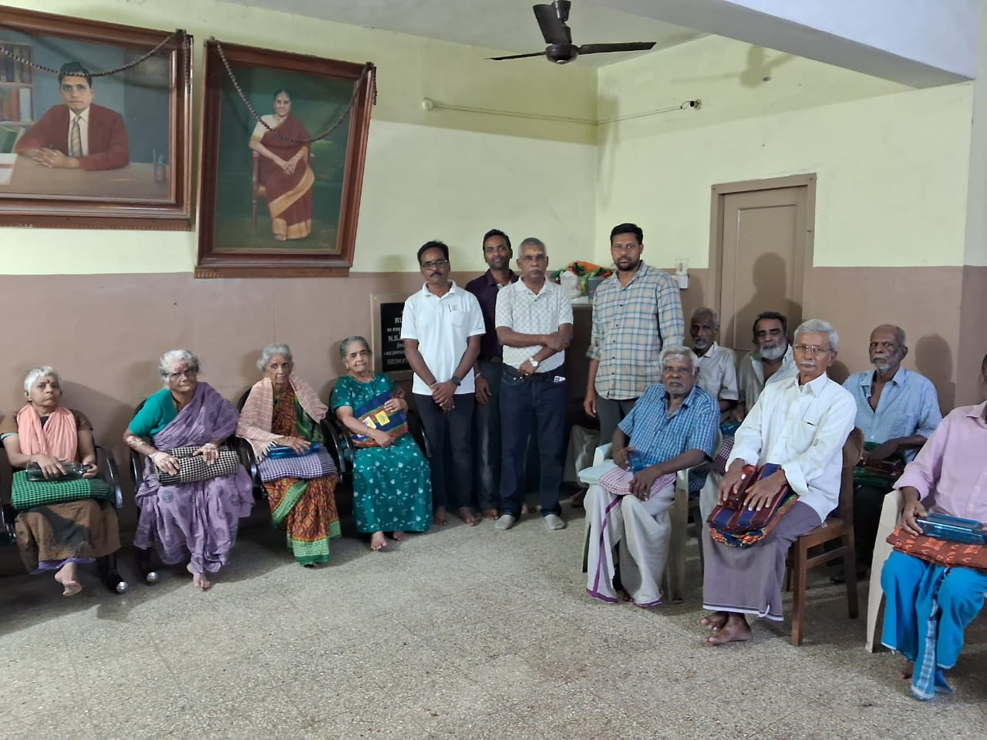
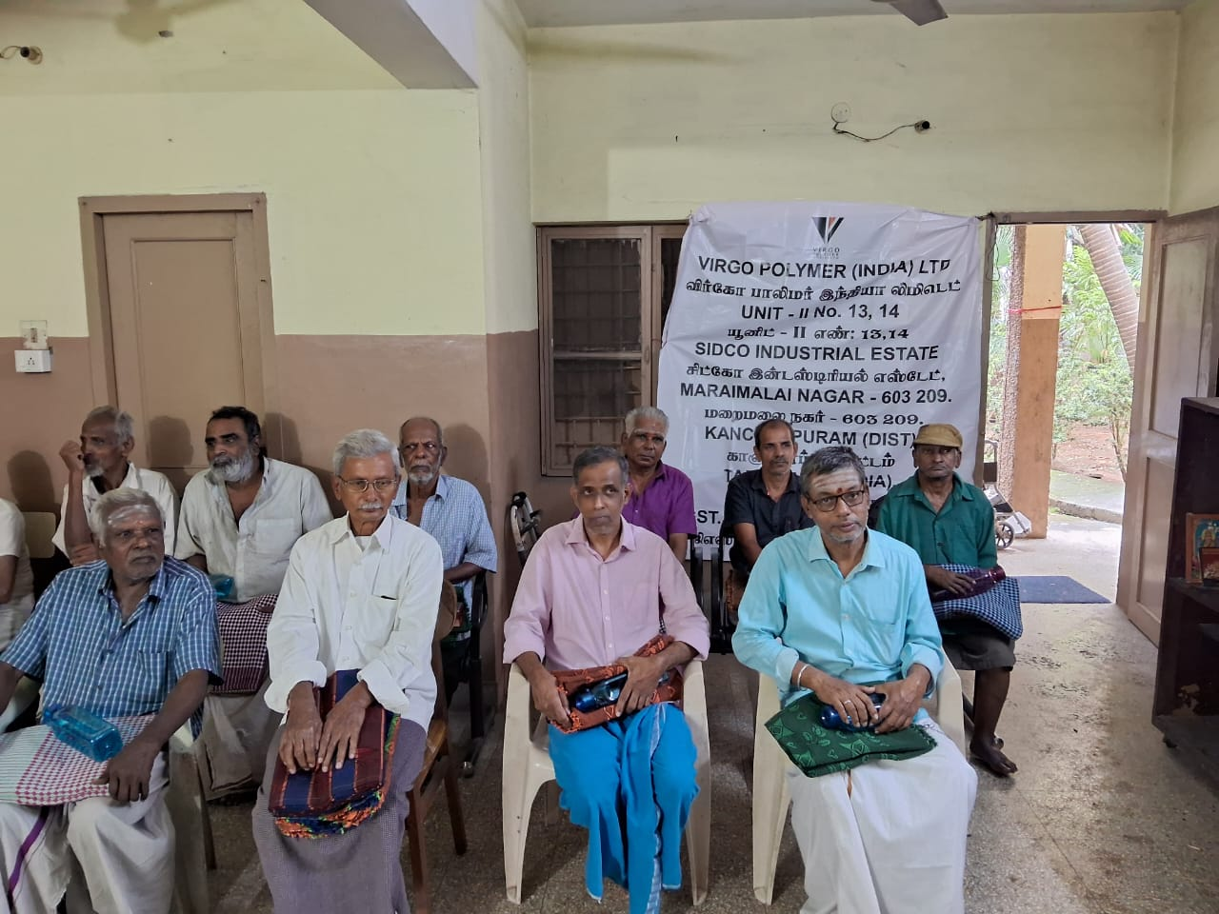
Community strengthening CSR activities
At Virgo Polymers, our commitment to corporate social responsibility (CSR) extends beyond business operations to making a positive impact on our local community. In a heartfelt initiative, we recently collaborated with a local old age home to bring comfort and warmth to its residents.
Blanket and pet bottle distribution campaign:
Understanding the challenges faced by the elderly, especially during colder seasons, we initiated a blanket distribution campaign. Virgo polymers distributed warm and cozy blankets to the residents of the local old age home. This gesture aimed not only to provide physical warmth but also to convey a sense of care and community support to those who may be vulnerable or in need.
In addition to blankets, we extended our support by distributing reusable pet bottles to the elderly residents. Recognizing the importance of hydration for overall well-being, especially in older age, these bottles were provided to encourage and facilitate the intake of fluids. This initiative aligns with our commitment to promoting health and comfort within the community.

Slide 24
Supply chain Management
Virgo Polymers is steadfast in its commitment to maintaining a resilient and ethical supply chain. Through a proactive approach, the company conducts comprehensive training sessions for its suppliers, emphasizing the importance of adhering to the VPIL Code of Conduct. This training not only imparts essential ethical guidelines but also ensures alignment with Virgo's values and sustainability principles. To further enhance transparency and accountability, Virgo Polymers conducts on-site assessments and supplier risk evaluations, systematically evaluating and addressing potential vulnerabilities. Additionally, the company champions diversity within its supply chain through a dedicated Supplier Diversity Program, fostering inclusivity and supporting suppliers from diverse backgrounds. By actively engaging with suppliers through education, assessment, and diversity initiatives, Virgo Polymers aims to cultivate a robust, responsible, and sustainable supply chain ecosystem.
KPI’s | 1. % of Raw Material supplier assessment
 | 2. % of supplier Signed COC
 | 3. % training of buyer on sustainable procurement
Targets | 81 % of Raw material suppliers will be assessed by end of FY2023 100% of supplier will sign COC 100% training of purchase team on sustainable procurement
Sr. No. | Particulars | Strategic Indicator | Achieved 2022-23
1 | Supplier code of conduct Signed | % age / year | 100
2 | Supplier assessment on environmental, labour and human rights requirements | % age / Year | 76

Slide 25
HUMAN RIGHTS
At Virgo Polymers, our commitment to ethical business practices extends to the unwavering defence of human rights. We proudly stand against any form of exploitation, firmly adhering to principles that prohibit both child labor and forced labor within our operations and supply chains.
We vehemently condemn and prohibit the use of child labor in any facet of our operations. Our commitment to the welfare of children is unwavering, and we ensure that our workforce, suppliers, and partners share this dedication. Through stringent policies and monitoring mechanisms, we actively prevent and eliminate the possibility of child labor within the Virgo Polymers ecosystem.
We firmly rejects any form of forced or compulsory labor. We uphold the principles of free and voluntary employment, ensuring that all individuals within our workforce are engaged willingly and without coercion. Our suppliers and partners are held to the same rigorous standards, ensuring that every participant in our value chain operates in accordance with the fundamental principles of human dignity and freedom.
Our commitment to human rights is not static; it is an ongoing journey. Virgo Polymers maintains a continuous monitoring system to identify, assess, and address any potential human rights risks.
KPI’s | 1. Training on Human rights Issues
 | 2. Prevention of child labour and forced labour
Targets | 100 % trained employees on Human Rights Age verification and record maintenance of all employee and workers Zero tolerance in the event of breach
Human Rights Issues reported in Year 2022-23
S. No | Particulars | Details
1. | No. of child labor cases reported | 0
2. | Cases reported of forced labour | 0

Slide 26
Governance
Ethics and Grievances
Information Security
Governing Body

Slide 27
ETHICS & GRIEVANCES
At Virgo Polymers, we believe in conducting business with the highest standards of ethics and integrity. Our commitment to ethical practices extends to the establishment of a robust grievance mechanism that ensures transparency, accountability, and a fair resolution of concerns within our organization.
Ethical business conduct is not just a policy at Virgo Polymers; it is an integral part of our organizational culture. We adhere to a set of ethical principles that guide our decision-making processes, fostering a workplace where integrity, honesty, and fairness prevail. Our ethical framework is designed to promote responsible practices, not only within our immediate operations but also throughout our supply chain.
Our commitment to a strong grievance mechanism, anti-sexual Harassment policy, and whistleblowers policy reflects our dedication to fostering an ethical, transparent, and accountable workplace for the well-being of our employees and the success of our organization.
Our commitment to ethics and a robust grievance mechanism is not static; it is a commitment to continuous improvement. Virgo Polymers regularly reviews and updates its policies to align with evolving ethical standards and best practices. We actively seek feedback from our employees to enhance our mechanisms and address emerging challenges.
KPI’s | 1. Training on Code of Conduct
 | 2. No. of Incident reported, and actions taken
Targets | 100 % trained employees on COC Zero incident on breach of COC
Ethic related performance Year 2022-23
S. No | Particulars | Details
1. | No. of cased reported through Whistleblower mechanism | 0
2. | %. of employees trained | 100
3. | No of incidence reported on breach of information security | 0

Slide 28
INFORMATION SECURITY
At virgo polymers, information security is a paramount concern, and we uphold a robust and comprehensive set of practices to safeguard the integrity, confidentiality, and availability of our information assets. Our information security practices are meticulously designed to address the dynamic landscape of cyber threats and technological advancements. We implement industry-leading technologies and employ best practices in encryption, access controls, and network security to ensure the protection of sensitive data. Regular risk assessments and audits are conducted to identify potential vulnerabilities, and our dedicated information security team continuously monitors and responds to emerging threats. Employee training programs instill a culture of awareness and responsibility, emphasizing the importance of information security practices at every level of the organization. Our commitment to compliance with industry standards and regulations ensures that our information security framework is aligned with global benchmarks. At virgo polymers, we view information security as a collective responsibility and an integral part of our commitment to maintaining the trust of our stakeholders.

Slide 29
Governing body
At Virgo polymers, our governing structure is designed to ensure transparency, accountability, and the highest standards of safety across all facets of our operations. Our key governing bodies play pivotal roles in steering the company towards success while fostering a culture of responsibility and well-being.
Our Governance structure comprises Board of directors and Committees:
1. Board of directors: The board provides strategic guidance and oversees the overall direction of virgo polymers. Their collective vision and wealth of experience contribute to the company's growth and sustainability, ensuring alignment with our core values and ethical standards.
2. Safety committee: safety is a non-negotiable priority at virgo polymers, and our safety committee is dedicated to upholding the highest standards in this regard.
3. Canteen committee: The canteen committee oversees the operations of our canteen facilities, ensuring hygiene, nutritional value, and overall satisfaction.
4. Risk committee: the risk committee at virgo polymers is dedicated to identifying, assessing, and mitigating potential risks that may impact the company's operations. Comprising experts in risk management, finance, and operations, this committee works diligently to develop strategies that safeguard the company against unforeseen challenges.

Slide 30
VPIL ESG REPORT
2022-23
In case of any query or concern over our ESG Report 2022-23, please reach out to us at: info@virgopolymer.com

